Slide 1



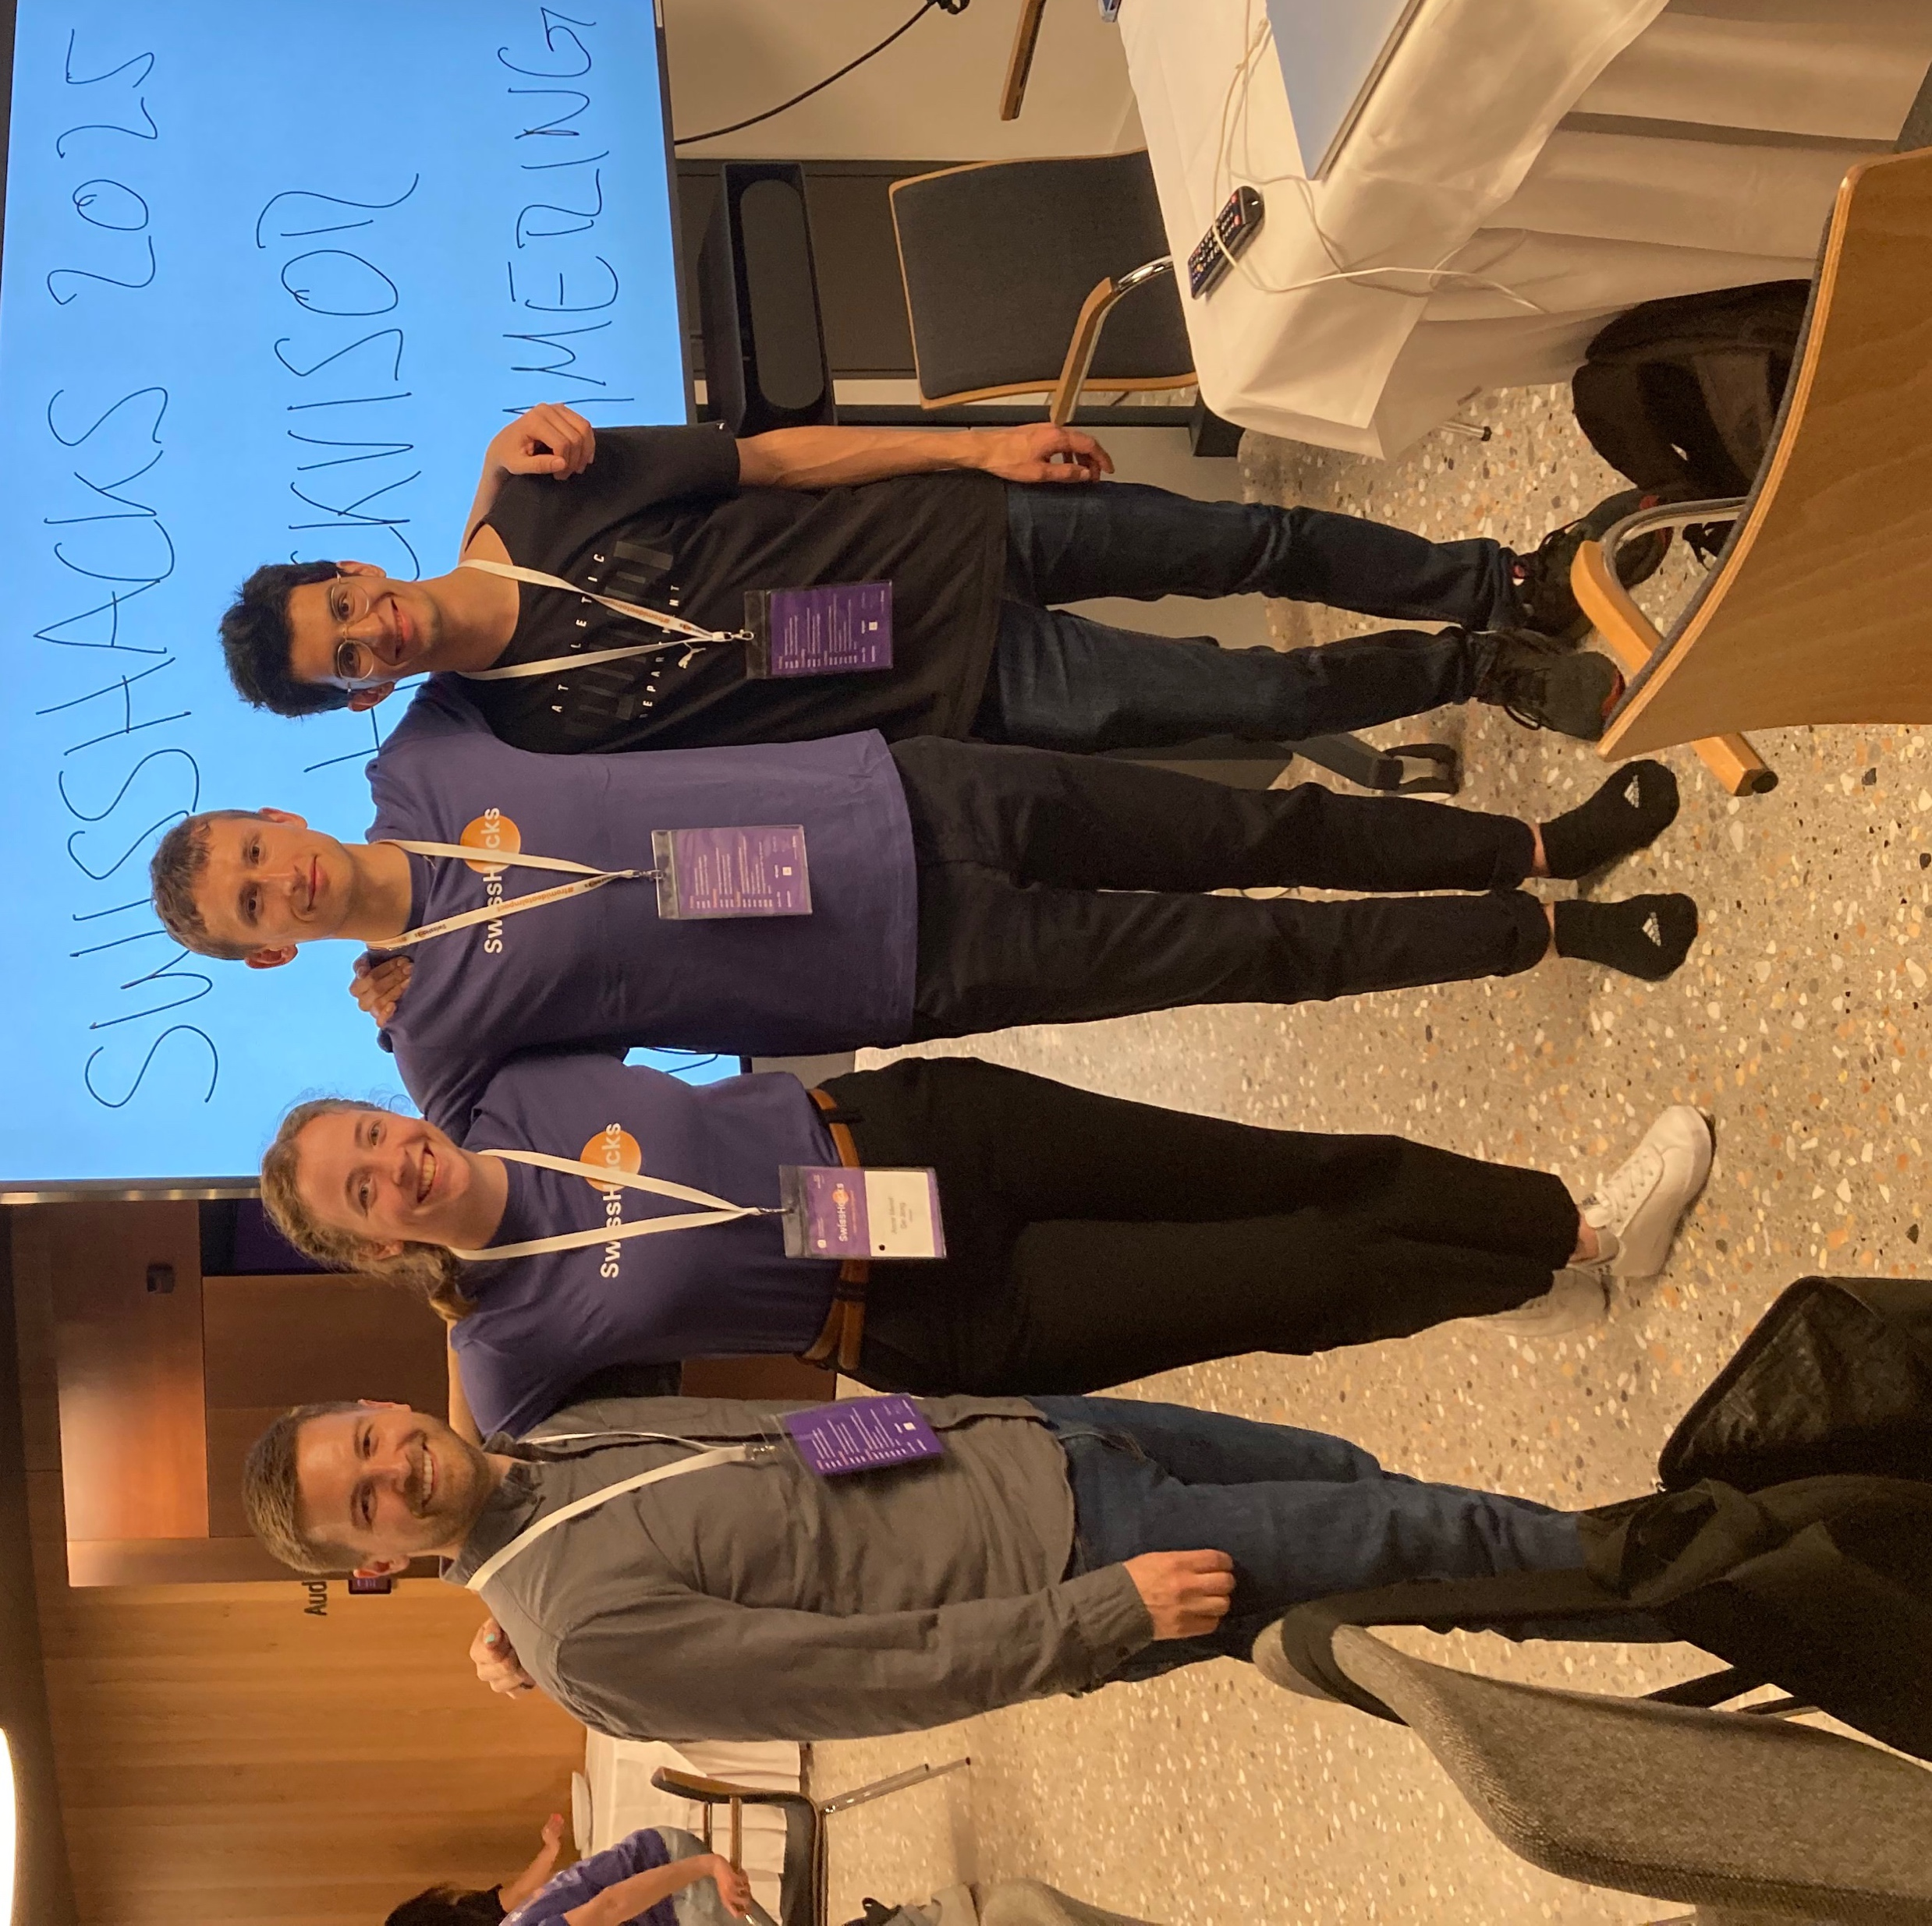




Team Hackvisor
Agentic AdvisorAssistant(AAA)
Make Advising Great Again®
Haris Alic
Anne Merel De Jong
Jonathan Reymond
Garrett Wisthoff

Slide 2



Problem Statement
Advisors need a solution to streamline and enhance working with clients
Administrative
tasksaretime
consuming
Clientdataquality
iserrorprone
Need for client centric AI recommendations

Slide 3
Introducing Agentic AdvisorAssistant
Reference data:
Client profile data
Client preferences
Product information
Advisor notes
Client/Advisor meeting transcripts
Transcripts
Client/Advisor meeting summaries
Client data quality issue identification
Advisor suggested actions and insights
AAA

Slide 4
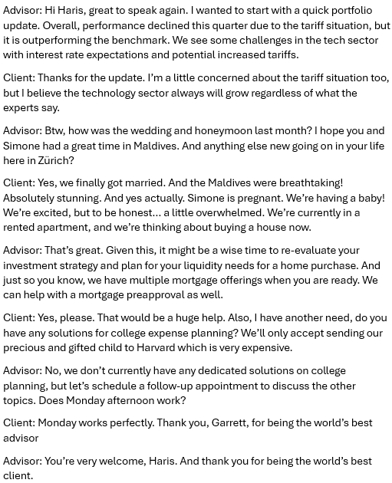
How it works
Meeting Transcript Ingestion (Speech to text)
Key Phrase Identification
AI Generated Recommendations
Client: “We’re thinking about buying a house now”
Client: “I believe the technology sector always will grow”
Client: “Yes, we finally got married”
Recommendation: Consider impact of new liquidity needs on client portfolio and discuss applicable mortgage options
Indicator: Client indicated a potential behavioral bias. Consider impact of confirmation bias in client management activities
Data validation: During the meeting, the client indicated they are married, but the Client’s Marital Status is listed as “Single”. Consider updating the client database

Slide 5

Demo

Slide 6




Summary
Benefits
Reduced manual tasks
Dataqualityissue
detection
Client situation
change assessments
Advisor insight reporting and recommendations

